Slide 1
INSTRUCTION SET ARCHITECTURE

Slide 2
Instruction Set Architecture(ISA)
An Instruction Set Architecture (ISA) is part of the abstract model of a computer that defines how the CPU is controlled by the software.
It is the part of Computer Architecture which is related to programming, instructions, registers, addressing modes, etc.
Instruction set : It is a combination of instructions, that a processor executes.

Slide 3
Instruction Set Architecture(ISA)
Bridges the hardware/software co-design
Compiler developer use ISA to develop compilers.
CPU designers design a CPU to implement the ISA.
Some open source examples:
MIPS32/MIPS64
RISC-V

Slide 4
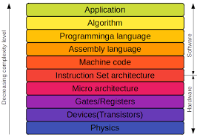
Instruction Set Architecture(ISA) The Hardware-Software Interface

Slide 5
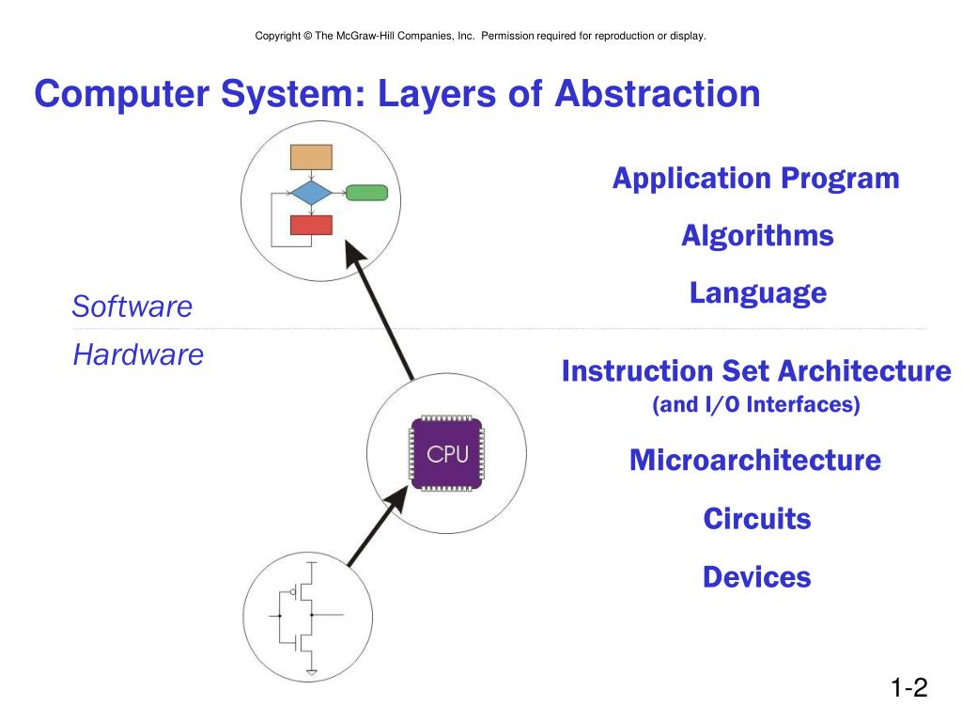

Slide 6
Instruction Set Operations
Arithmetic/Logical : Integer ALU ops.
ADD , AND , SUB , OR .
Load/Stores : Data transfer between memory and registers.
LOAD , STORE (Reg-reg), MOVE (Mem-mem)
Control : Instructions to change the program execution sequence.
BEQZ , BNEQ , JMP , CALL , RETURN , TRAP
System : OS instructions, virtual memory management instructions.
INT

Slide 7
Instruction Set Operations
Floating Point :
FADD , FMULT
Decimal : Support for BSD
String : Special instruction optimized for handling ASCII character strings.
Graphics : Pixel operations, compression and decompression.

Slide 8
Instruction Set Operations
All machines generally provide a full set of operations for the first three categories.
All machines MUST provide instruction support for basic system functions.
Floating point instructions are optional but are commonly provided.
Decimal and string instructions are optional but are disappearing in recent ISAs. They can be easily emulated by sequences of simpler instructions.
Graphic instructions are optional.

Slide 9
Instruction Set Operations
Control Flow instructions
Four types are identifiable:
Conditional branches
Jumps
Procedure Calls
Procedure Returns

Slide 10
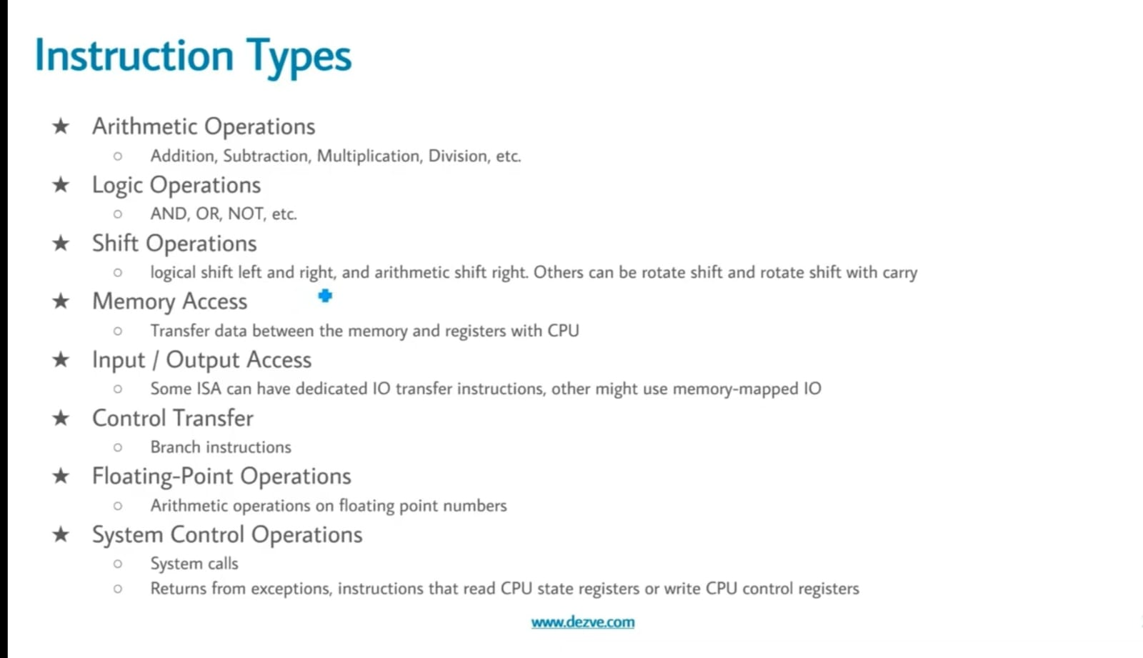

Slide 11
Types of Operands
Machine instructions operate on data. The most important general categories of data are:
Addresses
Numbers
Characters
Logical data

Slide 12
Types of Operands
Numbers:
All machine languages include numeric data types.
Three types of numerical data are common in computers:
Integer or fixed point
Floating point
Decimal

Slide 13
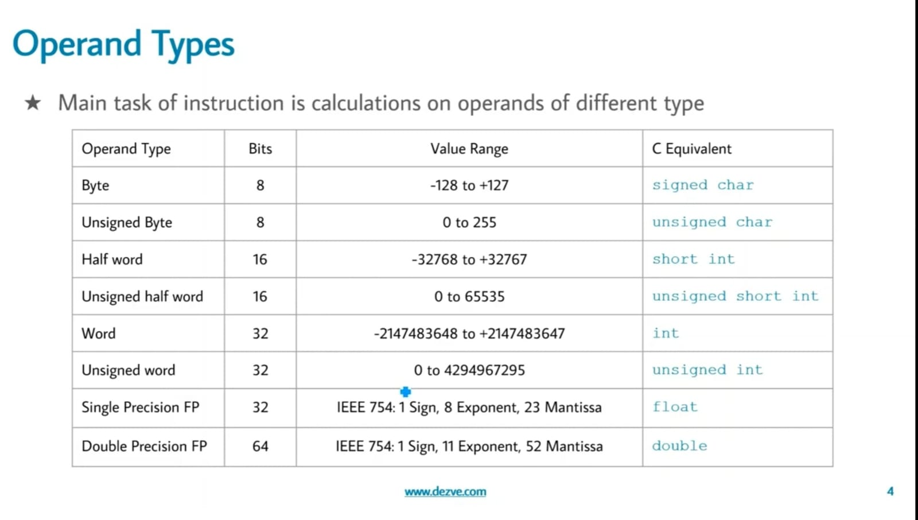

Slide 14
Instruction Set Architecture(ISA)
ISAs differ based on the internal storage in a processor. Accordingly, the ISA can be classified as follows, based on where the operands are stored and whether they are named explicitly or implicitly:
Single accumulator organization
General register organization
Stack organization

Slide 15
Single accumulator organization
Single accumulator organization, which names one of the general purpose registers as the accumulator and uses it to necessarily store one of the operands.
This indicates that one of the operands is implied to be in the accumulator and it is enough if the other operand is specified along with the instruction.

Slide 16
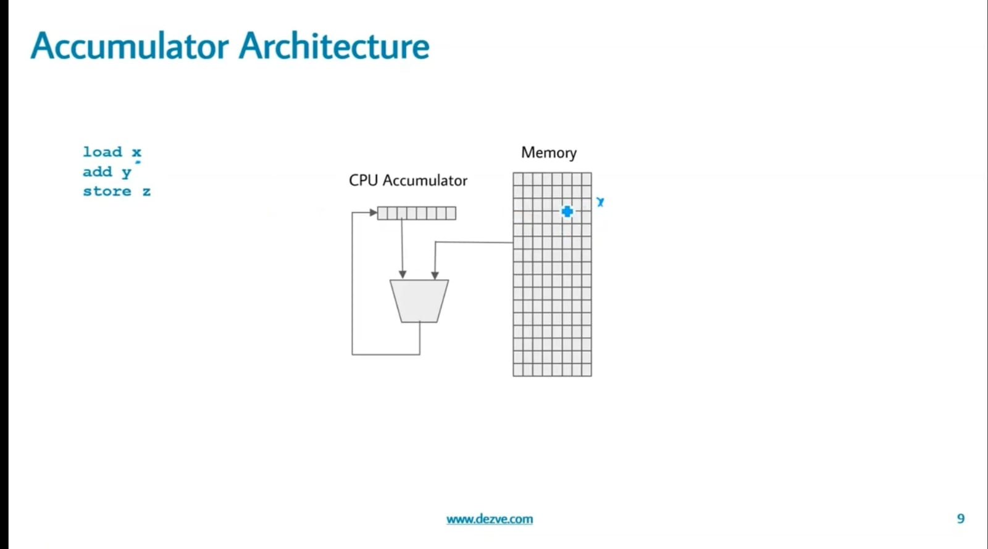

Slide 17
General register organization
General register organization, which specifies all the operands explicitly. Depending on whether the operands are available in memory or registers, it can be further classified as
– Register – register, where registers are used for storing operands. Such architectures are in fact also called load – store architectures, as only load and store instructions can have memory operands.
– Register – memory, where one operand is in a register and the other one in memory.
– Memory – memory, where all the operands are specified as memory operands.

Slide 18
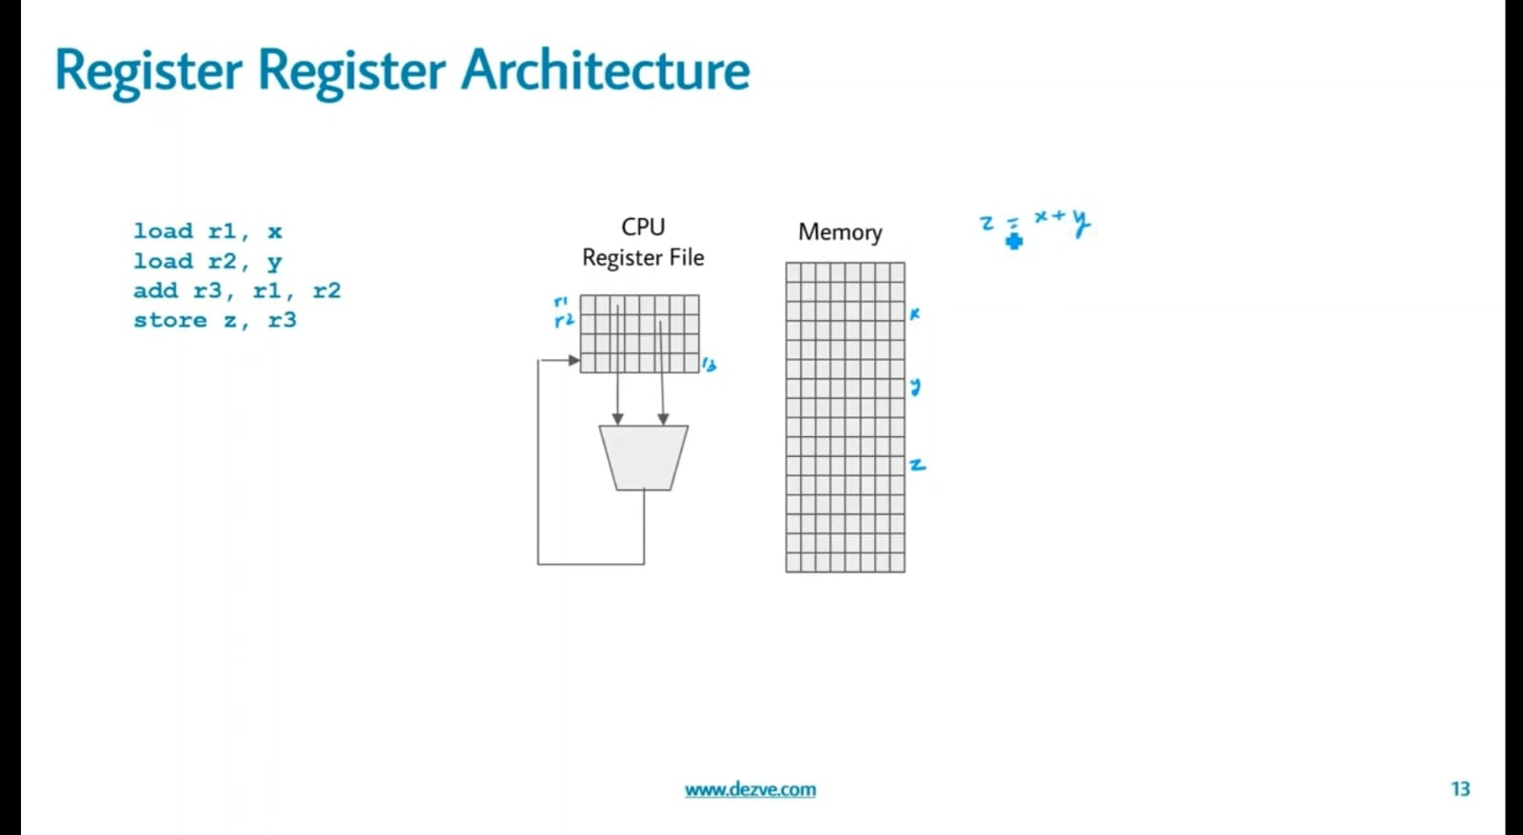

Slide 19
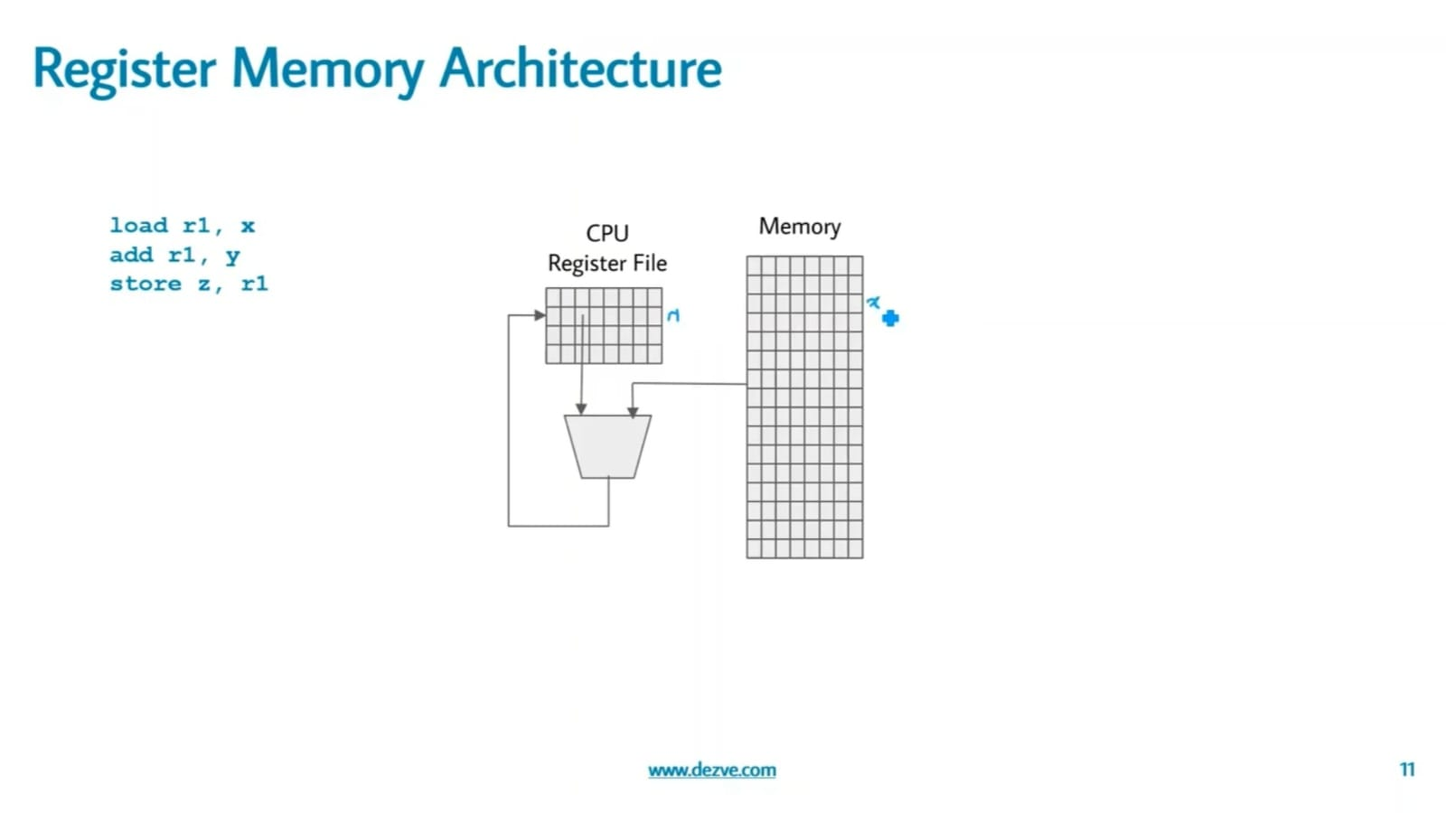

Slide 20
Stack organization
Stack organization, where the operands are put into the stack and the operations are carried out on the top of the stack. The operands are implicitly specified here.

Slide 21
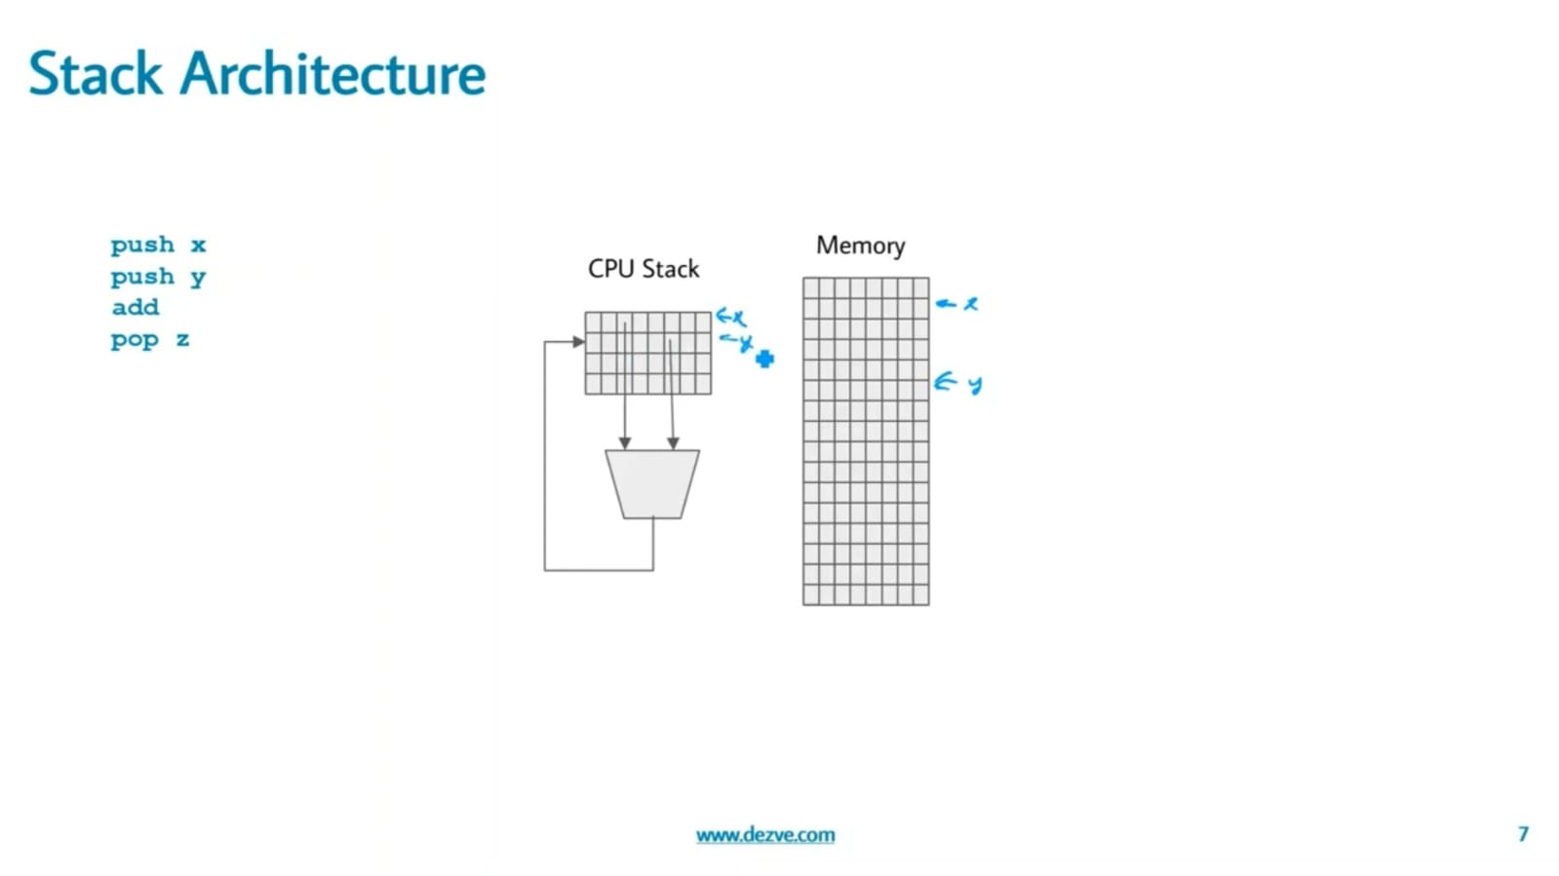

Slide 22


